Slide 1

AIGs mca forum
Presented by- Mohammed Faizan
(P18AJ21S0139)
Abhishek Kumar Boby
(P18AJ21S0142)
Project guide – Mr.Rajesh Rao K
(Assistant Professor)

Slide 2
Agenda
Introduction
Objective
Technology Platform
Website Architecture
Website Features Overview
Implementation With DFD
Website Screen shots
Conclusion
Future work

Slide 3

Introduction
The project entitled “AIGS MCA Discussion Forum” allows students from the MCA Department of Acharya Institute of Graduate Studies (AIGS) to establish communication through an online platform, and allows students to help each other on a multitude of things such as Projects, Project Ideas, Coding Errors, etc. They can visit the forum and post questions on the forum, on a specific thread, and other students can reply to those questions.

Slide 4

Objective
Enhance communication channels among students beyond the confines of their classrooms, facilitating support and assistance in multiple ways.

Slide 5




TECHNOLOGY USED FOR DEVELOPMENT
Java Script
PHP
MySQL
PhpMyAdmin
HTML
CSS

Slide 6
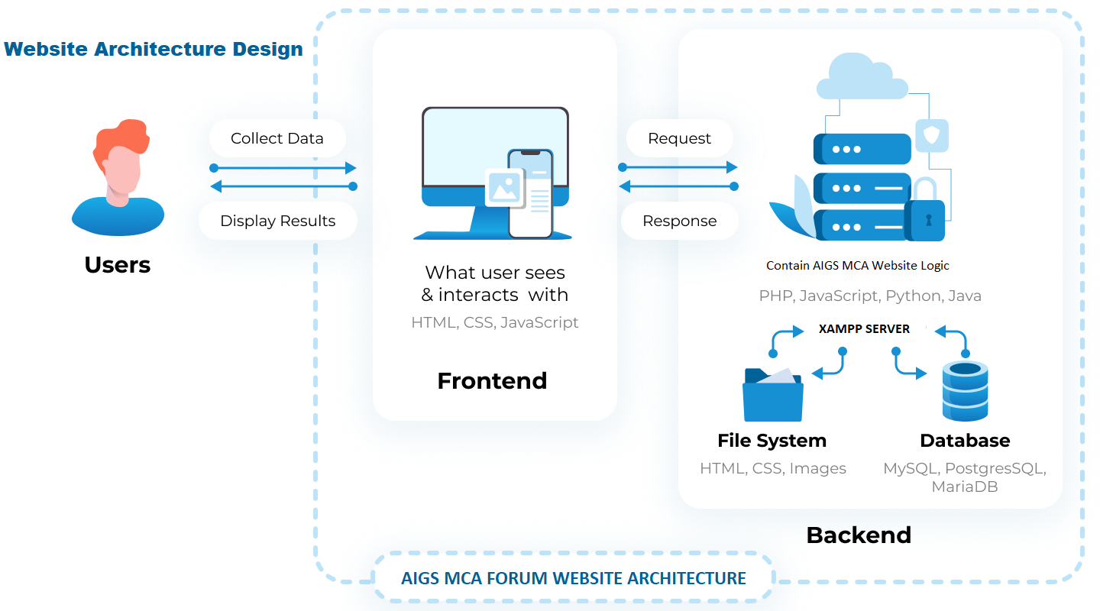

Slide 7
platform
Hardware Configuration
Platform: Windows 11 Home Edition
System: Ryzen 5 5600H
RAM: 8 GB
Hard disk: 500 GB
Software Configuration
Web server: XAMPP Server
Back end: MYSQL
Server-side scripting: PHP
Client-side scripting: HTML, JavaScript, Bootstrap 4

Slide 8
features & overview
User Profiles
Administrator Account
Threads & Comment Filter
The forum can have a dedicated section or knowledgeable members who provide technical support and guidance on programming languages, software tools, debugging issues, and other technical queries.
The forum facilitates networking among MCA students, enabling them to connect with peers from different institutions. It can include features like private messaging, user profiles, and the ability to create study groups or project teams.
The forum provides threads or forums where students can post questions, participate in discussions, and seek assistance on various MCA-related topics. These boards are usually categorized based on subjects. These threads and comments are also check for any inappropriate use of words.

Slide 9
features & overview
Edit/Remove Threads &
Comments
Technical Support
Collaboration
The forum can have a dedicated section or knowledgeable members who provide technical support and guidance on programming languages, software tools, debugging issues, and other technical queries.
The forum facilitates networking among MCA students, enabling them to connect with peers from different institutions. It can include features like private messaging, user profiles, and the ability to create study groups or project teams.
Granting users, the ability to remove their own comments provides greater control over their contributions. This feature allows users to rectify any mistakes, retract irrelevant or outdated comments, or delete content.

Slide 10
features & overview
Prevention of Inappropriate Words
Limited Functionalities for Guest Users
Cross Site Scripting (XSS)
Cross Site Scripting attack means sending and injecting malicious code or script. Malicious code is usually written with client-side programming languages such as Javascript, HTML, VBScript, Flash, etc. However, Javascript and HTML are mostly used to perform this attack.
The process involves creating a profanity word list containing offensive words, variations, and misspellings. An algorithm is developed to scan user-generated content, checking for the presence of profanity words. This can be achieved through exact match filtering, pattern matching, or contextual analysis. Before allowing content to be posted, it is validated for profanity words
Providing limited functionalities for guest users who have not logged in
Limitation include
Disabled Search
Not Allowed to post or comment
Proper measure against opening Profiles and Edit Profile PHP with manipulation of URL

Slide 11
Data Flow Diagram-
Registration Module
Register Module
Email_id
Email
UserName
Registration master
FullName
Password
Login Module
USN
Sem
Full name
Category Module DFD
Category id
Category
Module
Category master
Name

Slide 12
Post Question DFD
Email_id
Category Id
user Id
timestamp
Questions
Module
Question
Question
Question Desc.
Comment DFD
Email_id
Question Id
Comment Module
Comments
post Date
Comment

Slide 13
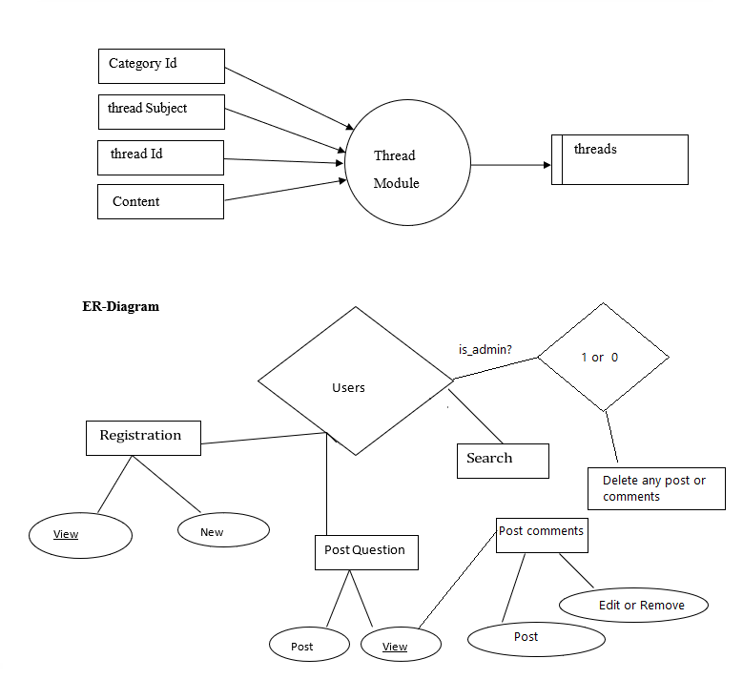
Threads DFD

Slide 14
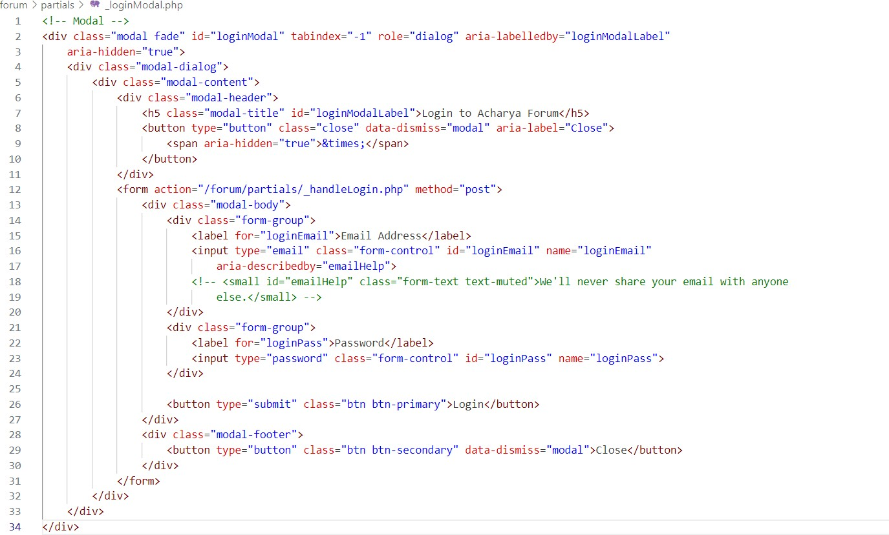
Implementation
Coding Login page
Login handle/validation:

Slide 15
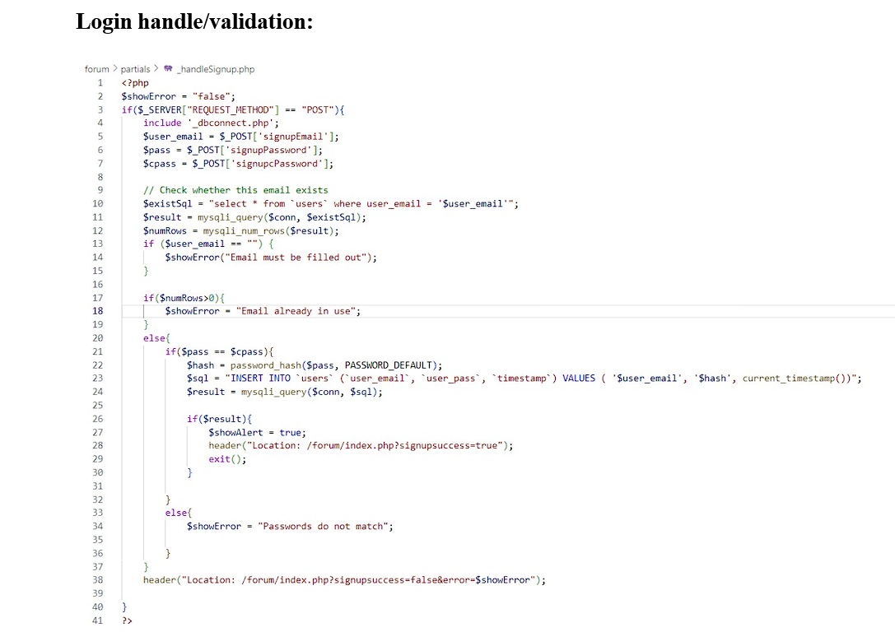

Slide 16
Test case & Result
LOGIN PAGE
Input | Excepted Result | Result
Click on the login button without entering your email and password | The user-friendly error message should be displayed to the user | Respective error messages are displayed to users
Click on the login button with entering invalid email and password | the error message should be displayed | the user-friendly error message is displayed
click on the login button by providing a valid email and password | the user should be able to login into the website | the user is logged into the website

Slide 17
Screenshots
MCA FORUM

Slide 18
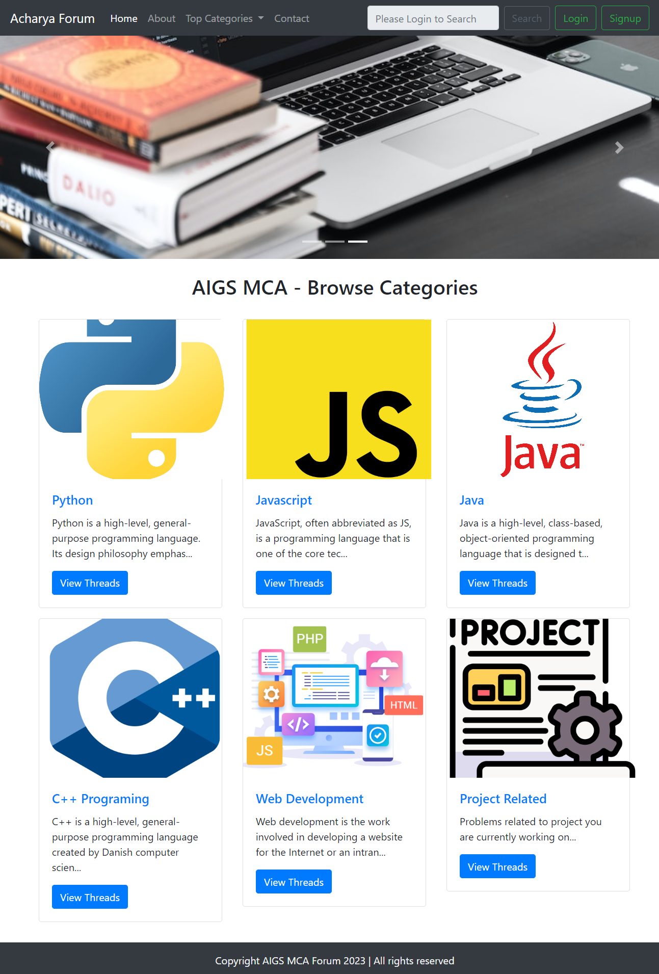
Home Page

Slide 19
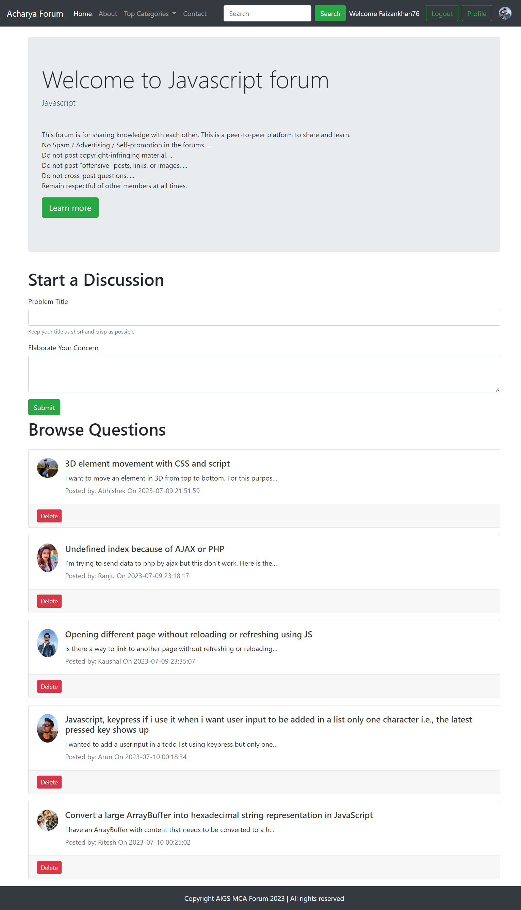
Threads list

Slide 20
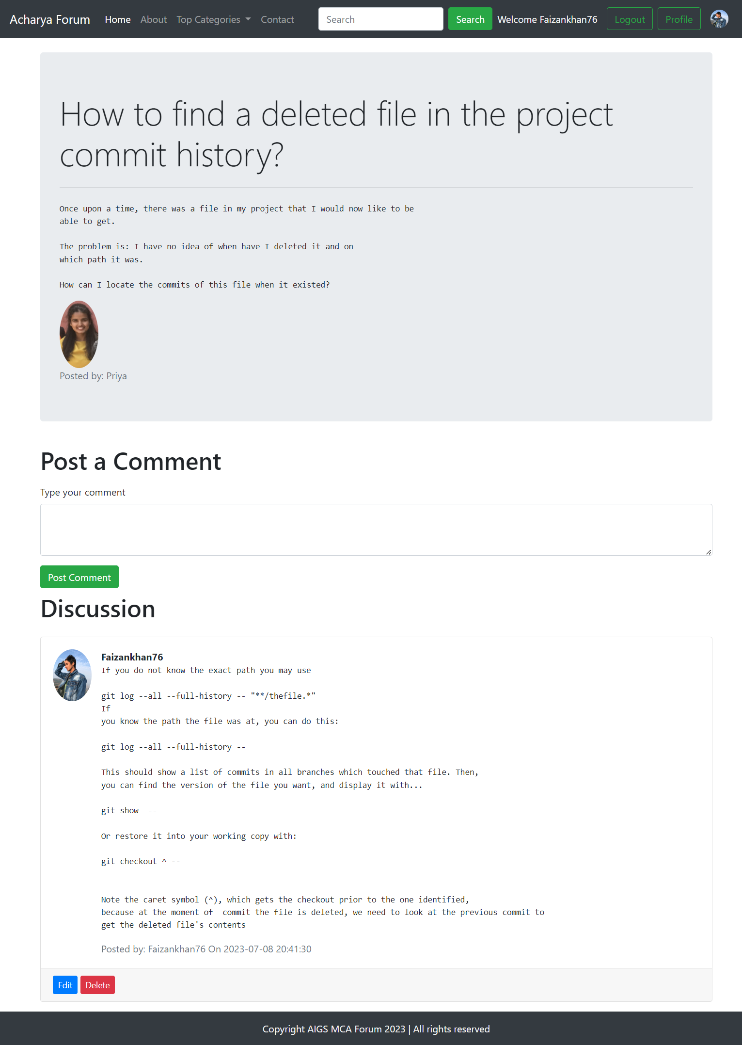
Thread

Slide 21
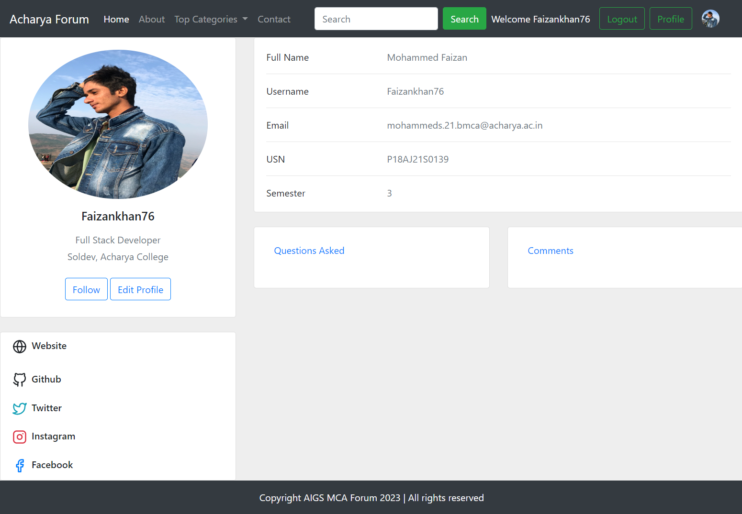
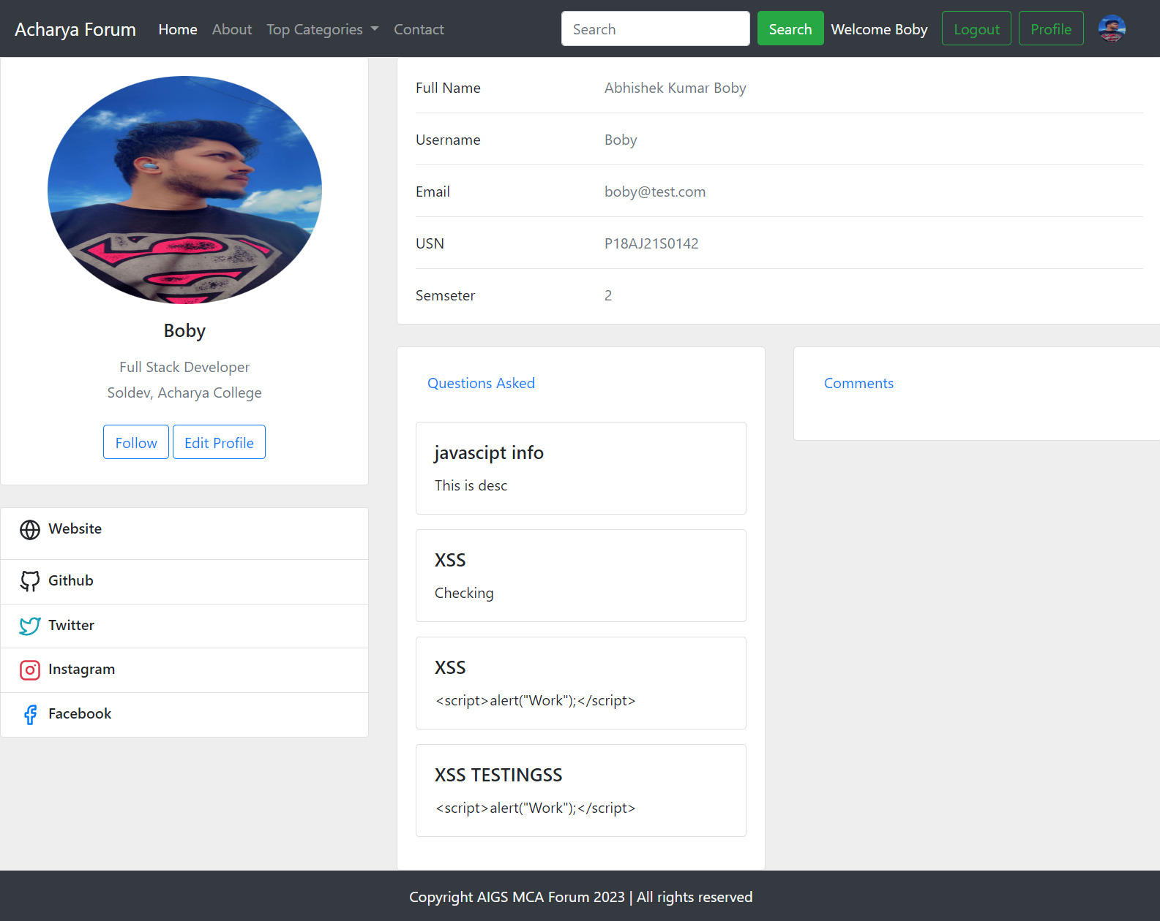
Profile

Slide 22

Conclusion
In conclusion, This forum will foster communications between students of MCA Department and serve as guide for those who are having problems in their codes and projects.
This forum (AIGS MCA Forum) can also improve student’s communicate skills and relationship amongst the students.

Slide 23
Future work
Adding Follow and Unfollow Functionalities
Implementing Like and Dislike Button
​
Adding a like and dislike button feature to the forum would enhance user engagement. Users can express their opinions on threads and comments by liking or disliking them. This feature can also help in sorting popular and relevant content based on user feedback.
Follow and unfollow functionalities are essential features in social networking platforms and online communities that allow users to connect and stay updated with other users. We may add this functionality on later date to enhance experience of users.
Private Message Service for Registered Users :
Implementing a private messaging system would allow users to communicate directly with each other. Users could send private messages, create group chats, and have a more personalized and private interaction within the forum

Slide 24
Any Questions?

